Slide 1

ESG-CV Update
Presented by Nicole Henson
HMIS System Administrator

Slide 2
Emergency Solutions Grants-CARES Act (ESG-CV)
The CARES Act appropriated $4 billion through the Emergency Solutions Grants (ESG) Program “to prevent, prepare for, and respond to coronavirus, among individuals and families who are homeless or receiving homeless assistance and to support additional homeless assistance and homelessness prevention activities to mitigate the impacts created by coronavirus under the Emergency Solutions Grants program.”

Slide 3
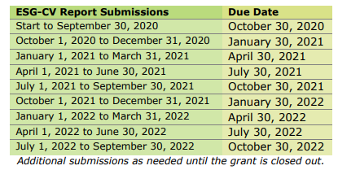
ESG-CV Report Submission Dates
HUD requires recipients of this ESG allocation to submit quarterly reports through the Sage HMIS Reporting Repository.
No reports submitted for the 1st and 2nd submissions
Deadline for expending ESG-CV funds has been extended to 9/30/2023

Slide 4

ESG-CV Update- 6/30/2022
3680 Clients have been Served by ESG-CV projects
613 Single Adults have been housed
128 Families have been housed

Slide 6
Total Clients Housed-6/30/22 Update

