Slide 1
FMCoC 2022 System Performance Measures Series
Notes:
Present brief over view and invitation to a follow up discussion series where we'll have time to unpack the data and discuss in more depth. We'll also be drawing connecting between these major reporting that is submitted by Fresno Housing as the HMIS Lead and the work we're doing with BFZ during the Action Camps.

Slide 2
System Performance Measures
Purpose: to help communities gauge their progress in preventing and ending homelessness and provide a more complete picture of how well a community is achieving this goal.
Measure 1: Length of Time Persons Remain Homeless
Measure 2: The Extent to which Persons who Exit Homelessness to Permanent Housing Destinations Return to Homelessness
Measure 3: Number of Homeless Persons
Measure 4: Employment and Income Growth for Homeless Persons in CoC Program-funded Projects
Measure 5: Number of Persons who Become Homeless for the First Time
Measure 7: Successful Placement from Street Outreach and Successful Placement in or Retention of Permanent Housing
Notes:
Background about System Performance Measures These are the priorities that HUD has established and evaluated CoC's on since 2014. They're due every year in late February.

Slide 3
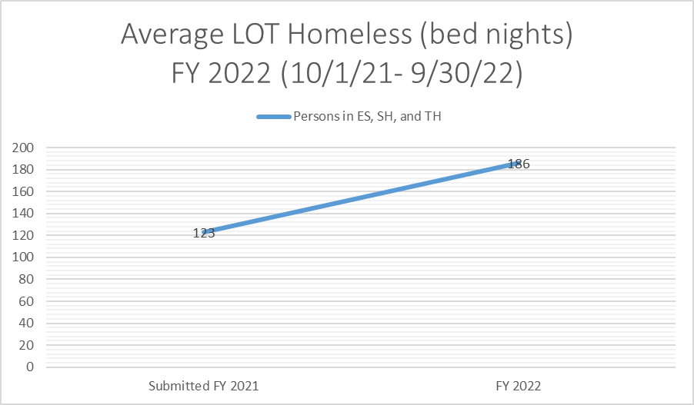
Measure 1: Length of Time Persons Remain Homeless
Questions to consider:
What factors do we think contributed to increasing LOT homeless for clients in our system, during this reporting period?
Is your agency currently implementing strategies to reduce the LOT homeless for your clients? What are they?
How can we measure the impact of the strategies you are testing?
An increase of 63 days homeless for clients in our system
Notes:
This measure includes bed nights from client entry to exit.

Slide 4
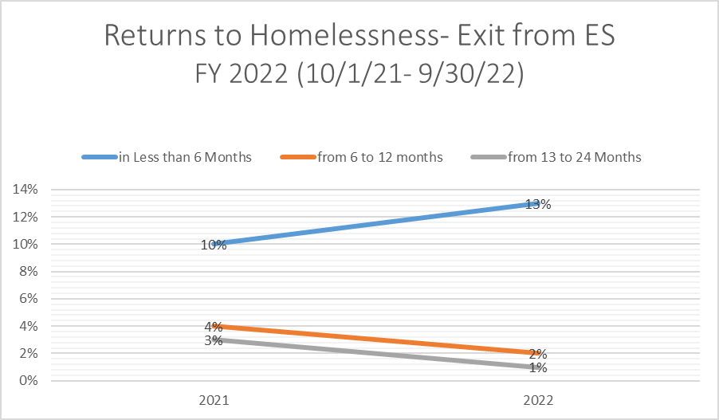
Measure 2: The Extent to which Persons who Exit Homelessness to Permanent Housing Destinations Return to Homelessness
Questions to consider:
What could account for the difference in clients re-entering the system after exiting from Emergency Shelter, at less than 6 months, 12 months, 13 months and more?
What is needed to help clients move forward in the housing process instead of exiting and re-entering ES at increasing rates?
Notes:
Chart displays the rate of return to homelessness. Overall in Measure 2, we improved the rate of returns to homelessness by 3%- round of applause for those in the Permanent Housing destinations. As we drill down into the comparative data we see that returns from ES results were more mixed. Shows that clients who were in the ES projects longerfrom 6-12 and 13- 24 months, returned to our system less often than those who exited ES before 6 months.

Slide 5
Attend the next HMIS Coffeetalk to join the discussion on these measures!
When? Tuesday, March 28th @ 10am
Where? Teams Video Conference
Link: https://tinyurl.com/FMCoCSPM1
See you there!

